Slide 1
MS Brain Health global impact
Survey results and case studies
A review of the impact of MS Brain Health – 5 years after publication of our report
March 2021

Slide 2
Overview of contents
Presentation aims
MS Brain Health: background, recommendations and standards
MS Brain Health global impact: quantitative survey results
  Summary of participant demographics and perspectives
  Impact reported by healthcare professionals
  Impact reported by people with MS or their carers
  Key findings from impact survey
MS Brain Health global impact: qualitative case studies
  ‘Impact’ case studies: by country or region
Conclusions and implications for future work

Slide 3
Presentation aims
Contents
Highlight the approach to the management of multiple sclerosis (MS) recommended in an evidence-based policy report published by global MS experts in 2015¹
Review areas of global impact from the resulting MS Brain Health initiative, since 2016
  An online survey provides measurable responses to questions posed using a systematic approach
    Demographics of participants
    Some whole group response summary data
    Responses from healthcare organizations
    Responses from people with MS and carers of people with MS
  A series of case studies showcases activities and improvements to care pioneered by groups within the MS community globally
Summarize the key achievements of MS Brain Health and the group’s aspirations for future activities to help implement the recommendations¹ and consensus standards²
1. Giovannoni et al. Mult Scler Relat Disord 2016;9 Suppl 1:S5–S48; 2. Hobart J et al. Mult Scler J 2019;25:1809‒18

Slide 4


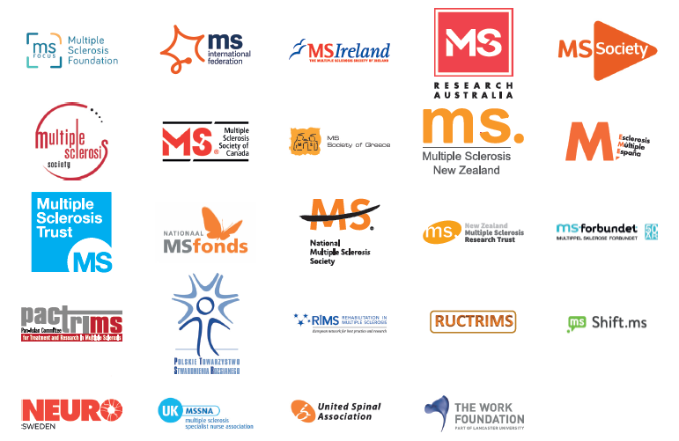

What is MS Brain Health?
Contents
An initiative that emerged from an evidence-based consensus report¹
Calls for a radical change in the management of MS
Global Steering Committee, 2020
  Gavin Giovannoni (Chair)
  Peer Baneke
  Helmut Butzkueven
  Jodi Haartsen
  Jeremy Hobart
  Anthony Traboulsee
  Timothy Vollmer
  Tjalf Ziemssen
Recommendations endorsed
by 50+ professional, advocacy
and patient organizations
440+ ‘brain health champions’
from >65 countries
1. Giovannoni et al. Mult Scler Relat Disord 2016;9 Suppl 1:S5–S48

Slide 5
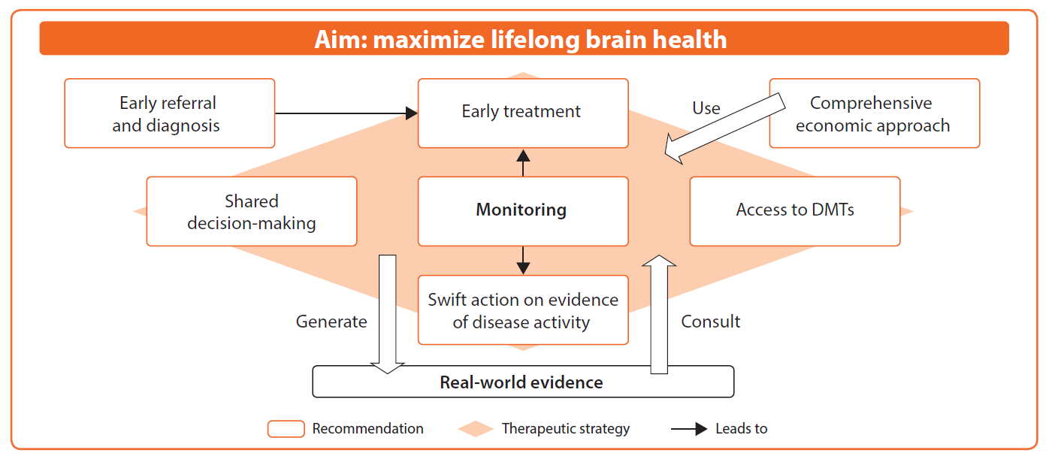
MS Brain Health recommendations: the cornerstone
MS Brain Health recommends a therapeutic strategy based on regular monitoring that aims to maximize lifelong brain health for people with MS while generating robust real-world evidence¹
1. Presented at the 31st Congress of the European Committee for Treatment and Research in Multiple Sclerosis (ECTRIMS), 7–10 October 2015, Barcelona, Spain

Slide 6
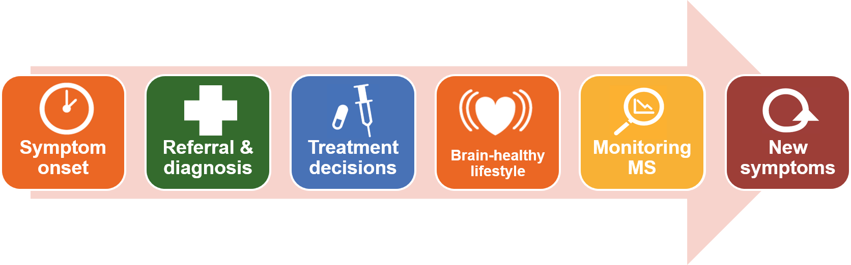

MS Brain Health consensus standards for the timing of key events in the MS care pathway¹
Monitoring MS
1. Research conducted using a modified Delphi process. Hobart J et al. Mult Scler J 2019;25:1809‒18

Slide 7
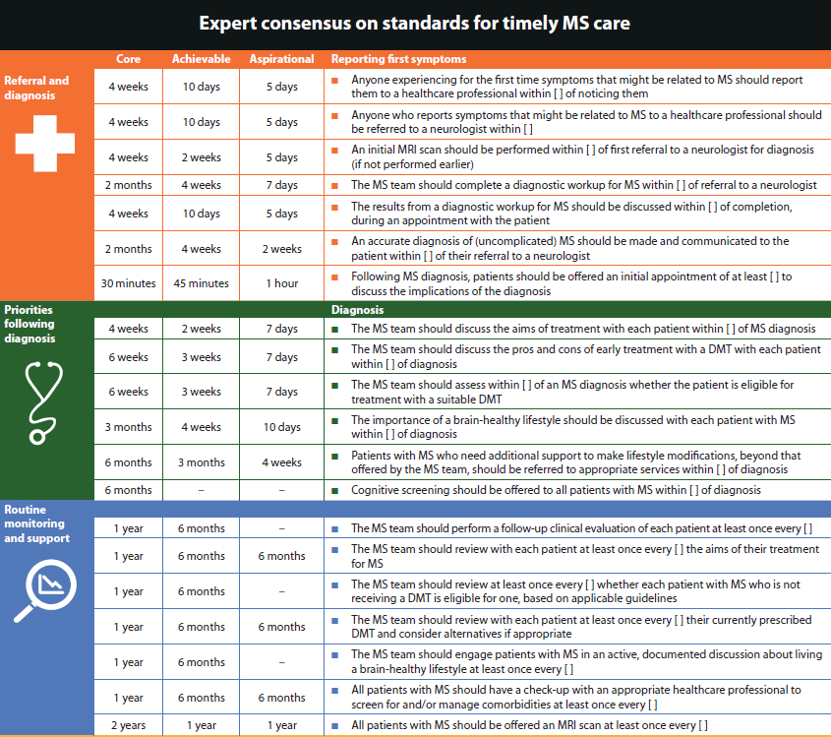
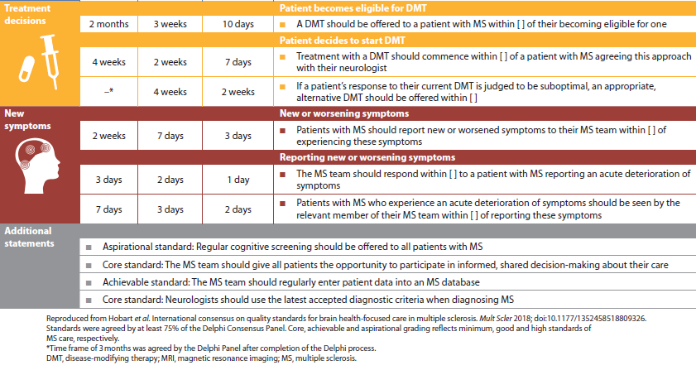
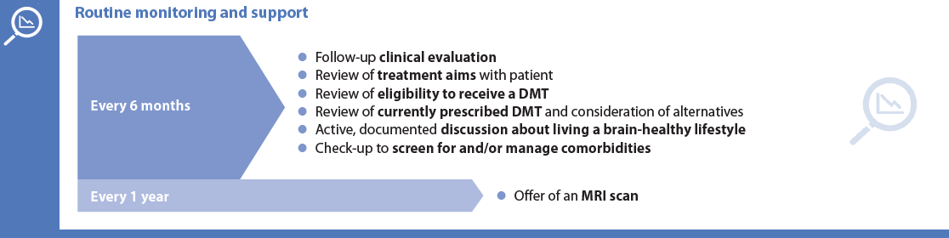
Consensus standards offer a choice of three levels to aim for: core, achievable, aspirational¹
1. Research conducted using a modified Delphi process. Hobart J et al. Mult Scler J 2019;25:1809‒18
1. Research conducted using a modified Delphi process.

Slide 8


MS Brain Health: assessing the impact of our global programme of work
Quantitative data
Qualitative data
Survey among MS community
Develop impact stories
Contact MSBH supporters to ascertain how and where MSBH resources are being used and how the report is influencing policy, practice and behaviour
Show impact on policy at local level
Gather anecdotes from personal contact with patient groups and endorsers
Generate content for dissemination via MSBH channels

Slide 9
MS Brain Health global impact: quantitative survey results
Contents
Survey completed October–December 2020

Slide 10
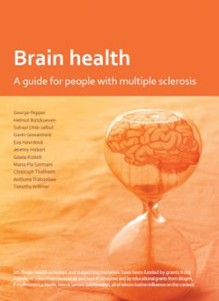
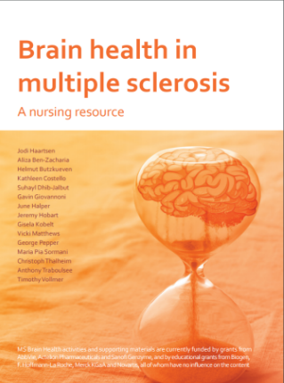
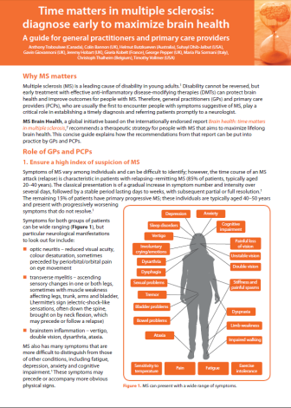
Survey aims and key objectives
Assess the global impact of the MS Brain Health initiative, including:
  Brain health: time matters in multiple sclerosis report¹
  consensus guidelines on MS care²
  resources for HCPs and for people with MS
Use a quantitative, systematic approach to evaluate changes in:
  personal management of MS care
  MS clinical services
  MS pathways or policies – local, regional or national
  investment in MS services
Gather specific examples of changes in some of these key areas
HCP, healthcare professional
1. Giovanni G et al. Mult Scler Relat Disord 2016;9 Suppl 1:S5‒S48; 2. Hobart J et al. Mult Scler J 2019;25:1809‒18

Slide 11
Methods: development and distribution of survey
MS Brain Health team and experts in health measurement research¹ collaborated to develop, pilot and conduct a structured online survey
Survey was distributed electronically by various means:
  Emails to MS neurologists who participated in Delphi research to develop
  MS Brain Health consensus standards (>20 individuals)
  Requests to national MS societies and professional groups (>40)
  Newsletters to all members of MS Brain Health mailing list (>1600)
  Twitter posts and blogs on relevant MS sites
Survey was distributed between October and December 2020
1. Experts from the Health Measurement Research and Innovation unit of Plymouth University assisted with the wording and programming of the survey and with analysis of the quantitative responses
Notes:
Authors of the ‘Delphi consensus’ paper and endorsers received individual emails
The database members received newsletters in October 2020 and December 2020

Slide 12

Invitees and respondents: global reach
Response rate was highest among those who were invited personally
Interest following newsletter mailings was also encouraging:
  196 clicks on survey link (169 in October; 27 in December)
100 individuals participated:
  20 countries
  4 continents
A broad mix of individuals participated:
  69 people from healthcare organizations
  25 people with MS or a carer/family member of a person with MS
  6 people from patient support groups or commercial organizations

Slide 13
Summary of participant demographics and perspectives
Contents

Slide 14
Overview of participants, by country
Country | Participants (n and %)* |  | Country | Participants (n and %)*
UK | 18 |  | Denmark | 1
Belgium | 16 |  | Egypt | 1
Australia | 14 |  | France | 1
Czech Republic | 11 |  | Germany | 1
Serbia | 9 |  | Ireland (Republic) | 1
New Zealand | 6 |  | Mexico | 1
Canada | 6 |  | Portugal | 1
US | 6 |  | Romania | 1
Norway | 2 |  | Spain | 1
Brazil | 2 |  | Greece | 1
*n=100 respondents

Slide 15
Breakdown showing roles of participants*
*n=100 respondents

Slide 16
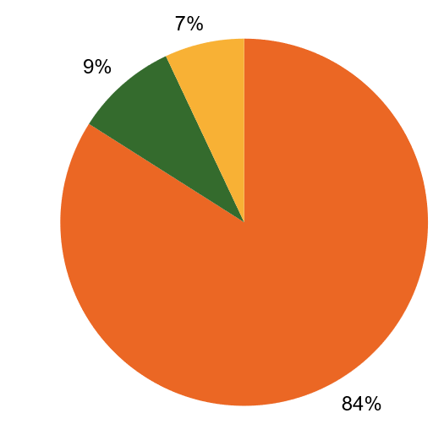
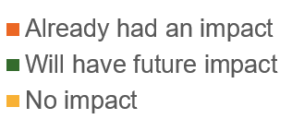
Current and future impact of MS Brain Health standards and recommendations: overall results
Similar questions about MS Brain Health impact were put to all survey participants
  HCPs: has MS Brain Health had an impact, or a likely future impact, on the service your organization provides for people with MS?
  People with MS and carers: has MS Brain Health had
  an impact, or a likely future impact, on your personal management of MS?
  Others: has MS Brain Health influenced how your organization supports the MS community?
HCP, healthcare professional
Responses gathered from 69 HCPs, 25 people with MS or their carers and 6 others (advocates, people from industry or professional groups)

Slide 17
MS Brain Health has had a global impact: here’s what some of the survey respondents said …
“Helped with establishing rapid pathways for newly diagnosed to be seen and commenced on treatment”
“MS Brain Health has certainly changed the way that leading MS neurologists view best practices in MS care”
“More availability of disease-modifying treatments for all MS patients equally”
“Directed the focus of our organization’s advocacy work”
“We have made sure politicians and health planners have copies of brain health. We are also participating in three centres in using the MS Brain Health auditing tool and look forward to the results”
“We have used MS Brain Health to ensure all of our staff and people with MS understand the importance of advocating for better care”

Slide 18
Impact reported by people working in healthcare organizations
Contents

Slide 19
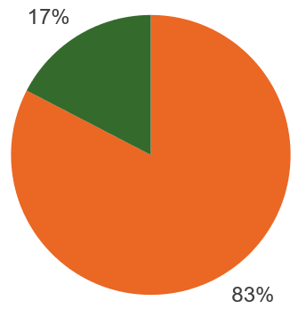
MS Brain Health approach is being adopted by many healthcare organizations
69 people working in healthcare organizations in 18 countries responded
The questions focused on the impact on their personal practice and changes to MS services locally and nationally
83% of HCPs reported that they or others in their
organization have made changes based on
MS Brain Health recommendations or standards
16 countries reported changes in practice
No changes
Made changes
HCP, healthcare professional
Notes:
Australia 10
Belgium 16
Brazil 2
Canada 4
Czech Republic 11
Denmark 1
Egypt 1
France 1
Germany 1
Greece 1
Mexico 1
NZ 3
Norway 2
Portugal 1
Romania 1
Serbia 7
UK 4
USA 2

Slide 20
















16 of the countries surveyed have changed their MS practice, thanks to MS Brain Health
 | Australia |  | Czech Republic |  | Greece |  | Portugal
 | Belgium |  | Egypt |  | Mexico |  | Romania
 | Brazil |  | France |  | New Zealand |  | Serbia
 | Canada |  | Germany |  | Norway |  | United Kingdom

Slide 21
Changes to clinical practice include patient education and new approaches to diagnosis and management
Areas where MS Brain Health has supported changes in practice within the healthcare organization of the respondents
Respondents (%)
n=69 healthcare professional respondents

Slide 22
Reported changes are far-reaching, including treatment access and changes in national policy
“Have seen an increased use of higher efficacy therapies in our area”
“Preservation of upper limb function”
“The lifestyle recommendations are part of newly updated standards for diagnostics and treatment of MS and NMO in Czech Republic”
“More
“Initiatives to speed up diagnosis and treatment”
“Updated criteria for reimbursement of MS DMTs”
“Greater acceptance of positive impact of early interventions, monitoring and the changes individuals can make”
“MS Research Australia policy adoption/ endorsement”
“…the Brazilian Academy of Neurology cites the MS Brain Health report in the documents that argue for a change in the standard national MS protocol”
DMT, disease-modifying therapy; NMO, neuromyelitis optica

Slide 23
MS Brain Health has influenced established regional and national MS care pathways
Areas where respondents have noted changes in MS care pathways or policies that have been supported by the MS Brain Health initiative
Respondents (%)
n=69 healthcare professional respondents

Slide 24
Investment in MS care has increased in some centres
Reported areas where MS Brain Health has supported
increased investment in MS Services
Respondents (%)
n=68 healthcare professional respondents

Slide 25
Impact reported by people with MS or their carers
Contents

Slide 26
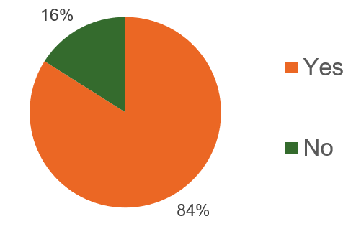
MS Brain Health has helped equip people with MS and their carers to manage the disease
The survey asked people with MS and their carers about the impact of MS Brain Health on:
  management of their MS (or that of the person they care for)
  the MS services they use
25 people in this group from eight countries completed the survey
“Have the MS Brain Health recommendations and consensus standards influenced how you manage your MS or the MS of the person you care for?”
Notes:
Australia 2
Canada 2
Ireland (rep) 1
NZ 1
Serbia 1
Spain 1
UK 14
USA 3

Slide 27
Changes in MS knowledge and self-management among survey respondents with MS
Respondents (%)
n=25 people with MS or carers who responded

Slide 28
Clinical care changes have been observed by people with MS … and are likely to continue
Do you feel there have been, or will in future be, changes in clinical care due to the MS Brain Health recommendations and consensus standards?
n=23 people with MS or carers who responded

Slide 29
Areas of change in clinical care reported by people with MS
If you have noted changes in MS clinical care due to
MS Brain Health, what have you seen?
Respondents (%)
n=23 people with MS or carers who responded

Slide 30
People with MS and their carers reported higher investment in MS services in some countries
Do you think MS Brain Health has increased or will
in the future increase investment in MS services?
n=25 people with MS or carers who responded

Slide 31
Areas of increased investment include improved monitoring and access to DMTs
Areas where people with MS reported that MS Brain Health
has helped support increased investment in MS services
Respondents (%)
DMT, disease-modifying treatment
n=25 people with MS or carers who responded

Slide 32
Key findings from impact survey
Contents

Slide 33
Country participation and reported impact
Countries that have made changes in practice/services and also seen an increase in investment based on MS Brain Health activity
  Czech Republic
  Serbia
  UK
Countries best represented in survey
  UK
  Belgium
  Australia
  Czech Republic
  Serbia

Slide 34
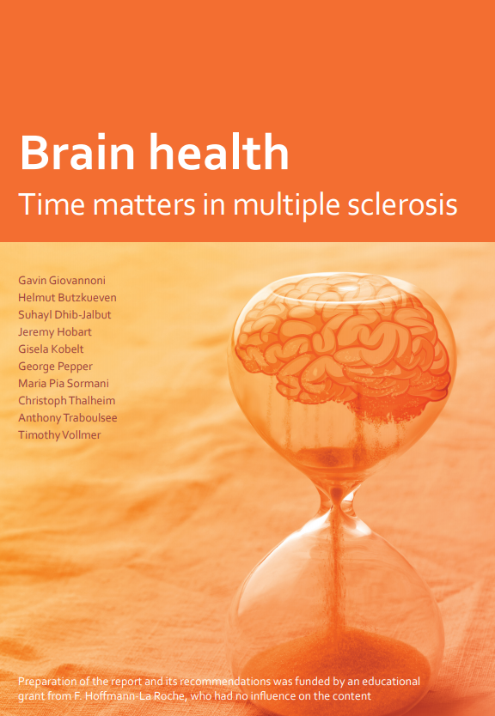
Areas where MS Brain Health has had most impact
Provided useful information for people with MS on preserving brain health (70% of respondents)
Provided information for people with MS on the impact of lifestyle choices (62% of respondents)
Promoted changes in monitoring approach
(42% of respondents)
Influenced established clinical best practice recommendations for diagnosis and treatment of a person with MS (52 responses)*
n=100: 69 healthcare professionals, 25 people with MS, 3 advocates, 3 ‘other’ (industry or private healthcare)
*Evidenced as a change in local, regional or national care pathways. 32‒52 respondents: some respondents may have selected more than one item, i.e. regional and national care pathways or local and regional/national care pathways
Notes:
Preserving brain health: 64% of HCPs (n=44); 80% of PwMS (n=20)
Impact of lifestyle choices: 74% of HCPs (n=51); 44% of PwMS (n=11)
Approach to monitoring: 45% of HCPs (n=31); 44% of PwMS (n=11)
Diagnosis and treatment pathways: regional or national: 38% and 25% of HCPs (n=26 and 17, respect); local or regional/national: 13% and 9% of PwMS (n=3 and 2, respect); so range is 29-48 separate answers)

Slide 35
Thank you for sharing your experiences
We would like to express our gratitude to all those people who took the time to complete the online survey
Beyond the use within this summary overview, the results have been extremely useful for the MS Brain Health Team
We are delighted to be able to evidence and share such
wide-ranging and positive impact

Slide 36
For any questions
For further information about MS Brain Health or this survey please visit:
https://www.msbrainhealth.org/
Or contact us via
info@msbrainhealth.org

Slide 37
MS Brain Health global impact: qualitative case studies
Contents
Some activities by national groups that have impacted local health policy and practice
Summaries updated June–December 2020

Slide 38
‘Impact’ case studies: by country or region
Contents
Australia
Europe
New Zealand
Norway
Serbia
Spain
UK
Global quality improvement tool: pilot I
Global quality improvement tool: pilot II

Slide 39
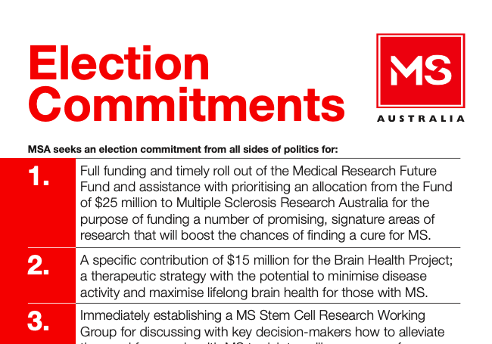
Influencing policy: MS Australia election commitments
MS Australia has played an active role in promoting MS Brain Health recommendations, by:
  asking the major political parties at the 2016 general election to commit to funding the implementation of the recommendations
  making a pre-budget submission to the 2017 federal budget to fund a project to help implement the recommendations
Outcome: Australian Parliament formally recognised World MS Day 2018 and acknowledged the importance of timely MS care, a brain-healthy lifestyle, and the need to increase investment in MS research

Slide 40

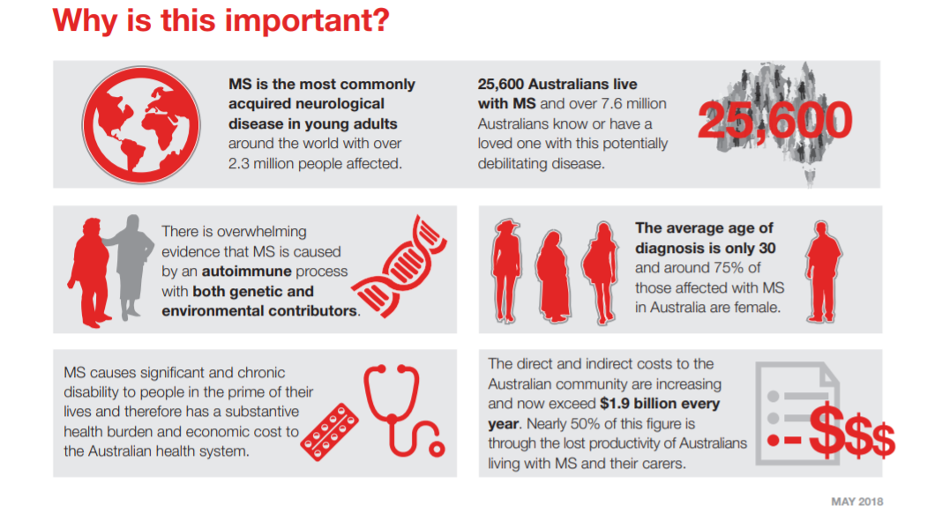
‘Election commitments 2019’ roadmaps in Australia: to mirror Government Ministerial portfolios
Improved management of MS
What needs to be done?
“Recognising the critical importance of early diagnosis and early treatment in minimising the impact of MS, increase understanding of MS within Primary Health and across the wider community to expedite diagnosis and referral to an expert in MS, as per the recommendations of the international consensus initiative, Brain health: time matters in multiple sclerosis”
DESTINATION: Access to early interventions and the most effective treatment therapy is well established
https://www.msaustralia.org.au/about-msa/2019-election-commitments-make-our-stories-matter

Slide 41
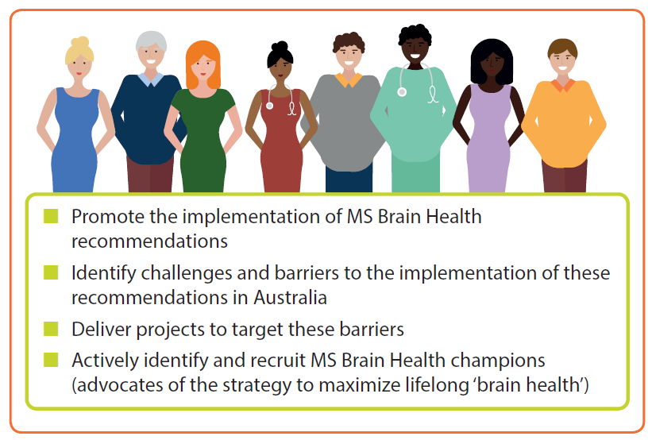

National advocacy: MS service improvements, Australia
Australian MS Brain Health Community
Aims and scope
2017: formation of first local
MS Brain Health group

Slide 42
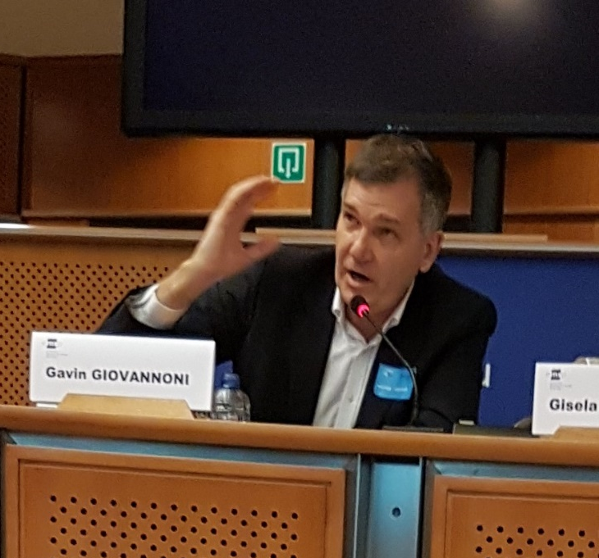

Advocacy for policy change: Europe-level advocacy by MS Brain Health leads
Promoted the importance of timely intervention in MS to policy makers in European Parliament (2017)
Gavin Giovannoni made the case that time is critical to:
  preserve brain reserve
  slow the course of MS
  improve quality of lives of people with MS
Gisela Kobelt set out the economic case for early intervention
  A cost-of-illness study across 16 countries involved almost 17,000 patients¹
  Costs of illness increased, on average,
  five-fold between mild and severe MS¹
1. Kobelt G et al. Mult Scler 2017;23:1123–36

Slide 43





National policy: challenging access and MS drug funding, New Zealand
Facing the challenge
  Difficulty for more than 20 years in getting timely and appropriate access to new MS drugs
  Implications for patients; precludes timely treatment initiation
  Requirement to stop treating if MS deteriorates by two EDSS points
Influencing decisions
  Submission to New Zealand Government drug-buying agency PHARMAC for extended access to DMTs
  Favourable recommendation from PHARMAC
Impact
  From March 2021, people with MS and EDSS score ≤ 6 have access to DMTs
  Two-step progression limit has been removed
DMT, disease-modifying therapy; EDSS, Expanded Disability Status Scale

Slide 44

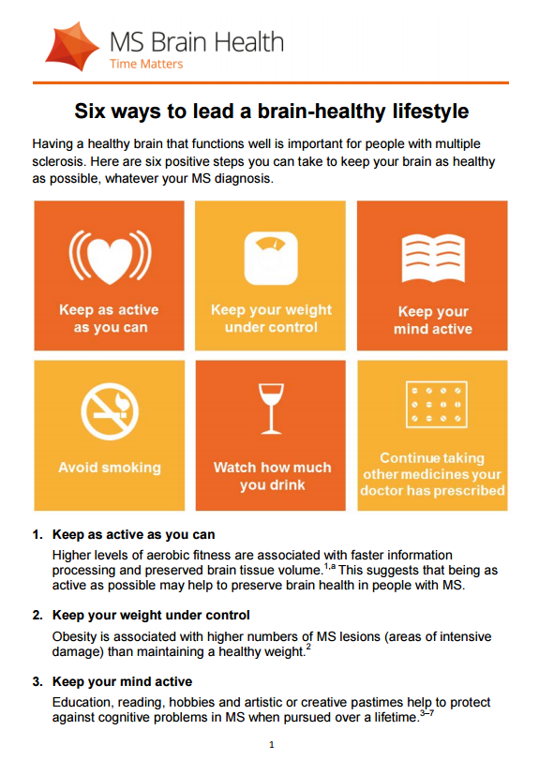

National advocacy and patient impact: reduced time to diagnosis and start of therapy, Norway
Norwegian Multiple Sclerosis Competence Centre
followed guidance from Time Matters in MS and
Six ways to lead a brain-healthy lifestyle
Impact
  Using Time Matters in MS has gradually reduced
  time to diagnosis in Norway
Education
  Six ways to lead a brain-healthy lifestyle is
  routinely given to newly diagnosed people with MS
time to diagnosis
“The MS Brain Health report and guides have influenced policy, practice and behaviour in Norway.”
MS Neurologist

Slide 45



Advocacy and policy impact: MS Society of Serbia
Identifying barriers
  9,000 people with MS in Serbia
  Limited access to therapy owing to financial constraints
  Poor understanding of need for new treatments
Using MS Brain Health resources
  Brain health: time matters in MS report translated into Serbian
  Supports argument for timely diagnosis and treatment initiation
  Gavin Giovannoni working with MS Society of Serbia medical board
Reaching the right audience
  Brain health: time matters in MS report submitted to government, including President,
  Prime Minister and Minister of Health and Finance
  Also shared with Director of Serbian Health Insurance Fund
  Ongoing communications with relevant parties
Gaining a voice
  MS Society of Serbia now has representation in the Serbian Health Insurance fund
  Collaboration established with MS Working Group of the Serbian Society for Neurology
  30 local associations meeting with healthcare professionals and patients

Slide 46


Clinical and patient impact: access to
MS treatments in Serbia
Advocacy to key stakeholders leads to direct, positive clinical impact and increased access to MS treatment options
  MS Society of Serbia worked with Gavin Giovannoni
  Brain Health: Time Matters in Multiple Sclerosis recommendations supported MS Society of Serbia mission
Funding for existing and novel MS treatments
~2500
Patients with MS with
access to treatment
Number of MS patients treated more than doubled

Slide 47


Patient impact and education: healthy living for people with MS, Spain
Inspiration
  In 2020, Esclerosis Multiple España launched their patient web site http://emforma.esclerosismultiple.com/
  Focused on physical activity and healthy living
Communication
  Several new items based on MS Brain Health included on www.esclerosismultiple.com
Networking
  MS Brain health report distributed to over 100 professionals working in MS in Spain
>100
people received MS Brain Health report in 2017, including professionals in MS care and rehabilitation working in MS associations and foundations

Slide 48

MS Brain Health leaflet prompted MS Society UK’s 2018 quit smoking campaign
Six ways to lead a brain-healthy lifestyle leaflet, led the MS Society UK to run a quit smoking campaign in 2018
  The campaign was part of the annual, national public health Stoptober campaign
It secured more than 100 regional and local pieces of media coverage, as well as 13 items of national coverage
More than 4000 people viewed a news story about the link between smoking and MS on the MS Society UK website

Slide 49
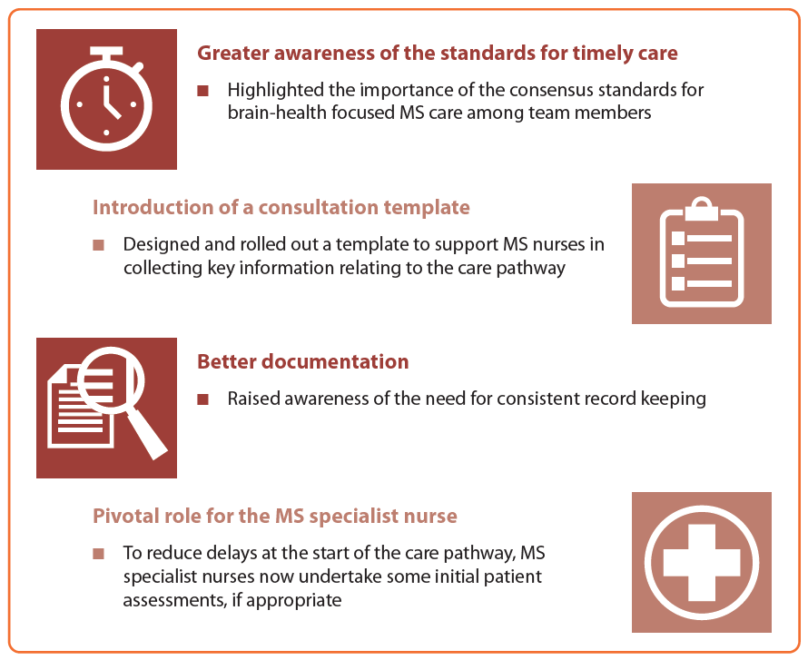

Global quality improvement tool: pilot I, 2018
Global quality standards for timely brain health-focused care were agreed by MS experts¹
  ‘Core’, ‘achievable’ and ‘aspirational’
  benchmarks were defined¹
These benchmarks were
incorporated into an Excel-based
quality improvement (QI) tool²
Prototype 1 of QI tool was piloted
in three MS centres in 2018²:
  Australia, Germany, UK
Local analysis of results led to improvements in clinical practice in those centres²
Impact of nurse-led quality improvement program in
Australia,³ from findings using MS Brain Health QI tool
1. Hobart J et al. Mult Scler 2019;25:1809–18; 2. Hobart J et al. Presented at 34th congress of the European Committee for Treatment and Research in Multiple Sclerosis, 10–12 October 2018, Berlin, Germany; Bowen A et al. Presented at Consortium of Multiple Sclerosis Centers Virtual Annual Meeting, 3 August 2020

Slide 50
Global quality improvement tool: pilot II, 2020‒21
Recommendations from MS centres
that participated in the 2018 pilot
were used to develop prototype II
In 2020, over 100 MS centres were invited to conduct a service evaluation using prototype II of the QI tool
More than 20 MS centres from
16 countries are now piloting the tool
  Pilot study II: aims
  Gather data on the quality standards
  Show that the data requested in the refined QI tool are relevant to MS centres in different settings and that, following local data analysis, the results can be used for service improvement in many countries
QI, quality improvement

Slide 51
Conclusions and implications for future work
Contents

Slide 52

Conclusions
MS Brain Health has had a global impact on MS care
Many leading neurologists have promoted local adoption of MS Brain Health recommendations and standards
Countries that have promoted local activities to drive change overlap, largely, with those reporting impact in the survey
Momentum builds when clinicians and patient groups collaborate
The ‘success’ stories supplied are the tip of the iceberg – further activity continues to build upon the
MS Brain Health foundations

Slide 53
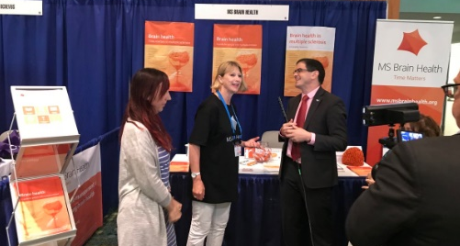
Implications for future work
Continue to be visible, communicate and build relationships
Support recommendations with evidence summaries, patient summaries and information resources
Encourage stakeholders to share learnings and engage new supporters through planned HCP and
patient summits
Share success stories!
  Email us at info@msbrainhealth.org
HCP, healthcare professional

Slide 54




How can YOU participate?
Share your success stories with us!
  Tell us about your MS Brain Health-inspired local event or best practice example to inspire other groups: info@msbrainhealth.org
Check our website for ideas from others
  www.msbrainhealth.org/global-impact
Let’s continue to work together to
make a global impact on MS care
Passionate individuals who want to make change happen
Case studies from groups that made an impact
Existing opportunities at local events
1. e.g. slide decks, PDF report, short summary reports, pledge cards
Notes:
We discussed this model at the January Steering Committee meeting. The local champions will know of the best opportunities in their countries.

Slide 55


