Slide 1
Guidance for presenters (1/4)
This slide deck is intended to inform healthcare professionals with an interest in MS about global consensus standards for timely MS care
Sections of this slide deck may be presented independently; however, the funding statement on the title slide should always be retained and presented alongside any material obtained from this slide deck
Please include your own Declarations of Interest statement at the start of the presentation, in keeping with the compliance regulations in your country and the country where the slides are being presented
Please see slides 18 and 19 for further guidance on how to use and tailor these slides appropriately for your region and audience

Slide 2
Guidance for presenters (2/4)
These slides are designed to stimulate debate. You may wish to include interactive questions for your audience throughout.
For example:
Does your clinic routinely check the quality of care you provide?
Are these standards achievable in your clinic?
YES
NO

Slide 3
MS Brain Health: embracing a global consensus on standards of care

Slide 4
Declarations of interest
[Please insert any relevant funding declarations here]

Slide 5

MS Brain Health vision and aim*
Our vision is to create a better future for
people with MS and their families
Our overarching aim is to encourage the
widespread adoption of a therapeutic strategy
that aims to maximize the lifelong brain health
of every person with MS
*Defined by MS Brain Health Steering Committee in 2015

Slide 6

Brain health: Time matters in multiple sclerosis Report published October 2015
Importance of brain health in MS and
the need for urgency at every stage
of the disease
Evidence-based recommendations
    Minimize delays in diagnosis and time to initiate treatment
    Set goals for treatment and ongoing management
    Generate and consult robust evidence
Authored by international experts and widely endorsed by professional societies and advocacy groups
Giovannoni G et al. Brain health: time matters in multiple sclerosis. Mult Scler Relat Disord 2016;9 Suppl 1:S5–S48

Slide 7






Following the report, MS Brain Health set out to…
…develop international standards for the timing of
key steps in the MS care pathway based on
policy recommendations in order to…
…create practical tools for MS clinics and
people with MS that will…
…help MS services worldwide strive for the highest level of care
Giovannoni G et al. Brain health: time matters in multiple sclerosis. Mult Scler Relat Disord 2016;9 Suppl 1:S5–S48

Slide 8
Developing international consensus standards for
MS care

Slide 9

Background and aims
Background:
Brain health: time matters in multiple sclerosis highlights the need for
timely diagnosis and management¹
  Variability in practice and care quality
  Absence of globally accepted standards
Quality standards would provide a benchmark for timely care globally
Aim:
Define ‘core’, ‘achievable’ and ‘aspirational’ standards
for the timing of key steps in the MS care pathway
(to reflect minimum, good and high standards, respectively)
¹Giovannoni G et al. Brain health: time matters in multiple sclerosis. Mult Scler Relat Disord 2016;9 Suppl 1:S5–S48

Slide 10

Completed a modified Delphi process to define international standards for MS care

Slide 11

The modified Delphi process
A structured approach for reaching consensus among experts, using surveys
  Opinions remain anonymous and are given equal weight
Participants from regions with a high prevalence of MS
Delphi Panel
(N = 29)
Reviewing Group
(N = 31)
Round 1 – comment on principles (n = 27)
Comment on results
Round 2 – suggest time frames (n = 24)
  Four Chairs led the process
  Delphi Panel of MS neurologists voted
  Reviewing Group commented (comprised MS nurses, people with MS and allied health professionals)
Round 3 – choose time frames (n = 24)
Round 4 – vote on statements (n = 21)
Comment on statements
Round 5 – vote on statements (n = 21)

Slide 12
Developing consensus statements
Time-related principles derived from the policy report
Principle
e.g. Early discussion about the importance of living a brain-healthy lifestyle
Variables defining principles in clinical practice developed
  MS neurologists suggested timings for ‘core’, ‘achievable’ and ‘aspirational’ consensus standards
Variable
e.g. Time from MS diagnosis to discussion about the importance of living a brain-healthy lifestyle
Consensus statements developed based on these timings
Consensus statement
e.g. The importance of a brain-healthy lifestyle should be discussed with each patient with MS within (xx days/weeks) of diagnosis

Slide 13

Three ‘levels’ of standards
Core: this should currently be achieved by most MS teams worldwide and will provide a
minimum standard
Achievable: this is a realistic target for most MS teams and reflects a good standard
of care
Aspirational: this might be achieved by only a few MS teams, where the local healthcare system allows, but should set the standard for high-quality care

Slide 14
Results of Delphi consensus research

Slide 15
Consensus reached on majority of time frames
In total, 21 neurologists from 19 countries…
…considered 27 statements at 3 levels
Threshold for consensus was at least 75% agreement on each statement, with at least 66% participation compared with round one
Consensus was also reached on four statements that were not time limited
Consensus reached on the majority of
core (25/27), achievable (25/27) and aspirational (22/27) time frames

Slide 16
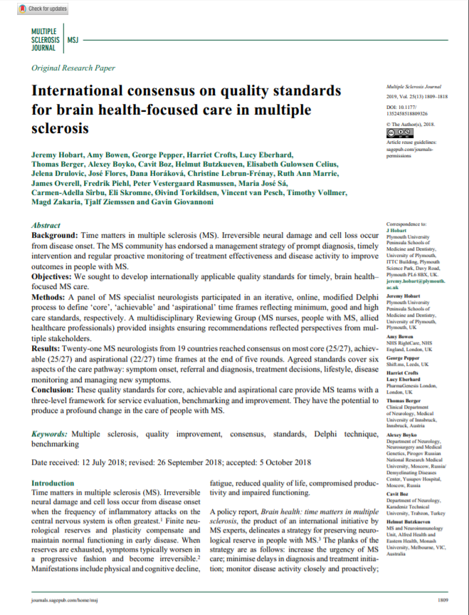
Consensus standards published in
Multiple Sclerosis Journal
In November 2018 the standards were published in Multiple Sclerosis Journal
The paper describes how consensus was reached and the standards developed
Hobart J et al. Mult Scler J 2019;25:1809–18.
Notes:
More information available here: https://www.msbrainhealth.org/resources/article/ms-brain-health-consensus-standards
Hobart, J. et al. (2019) ‘International consensus on quality standards for brain health-focused care in multiple sclerosis’, Multiple Sclerosis Journal, 25(13), pp. 1809–1818. doi: 10.1177/1352458518809326.

Slide 17
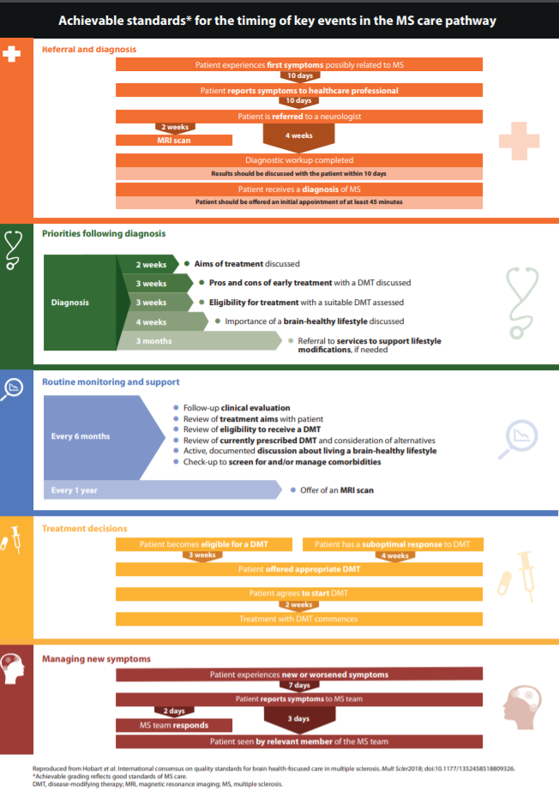
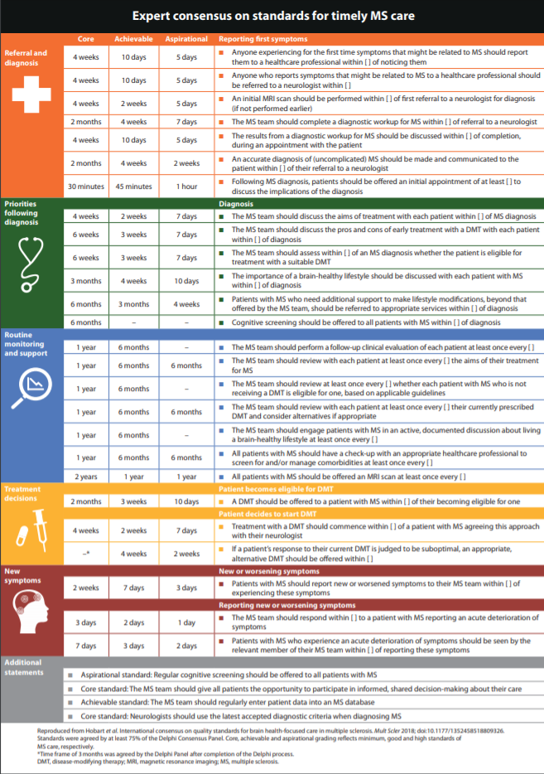
MS Brain Health consensus standards
https://www.msbrainhealth.org/resources/article/ms-brain-health-consensus-standards
Notes:
More information available here: https://www.msbrainhealth.org/resources/article/ms-brain-health-consensus-standards

Slide 18
Guidance for presenters (3/4)
The following section outlines the timings for core, achievable and aspirational standards at each stage of the MS care pathway. In your presentation, you may wish to focus on just one aspect or level of care
For example, you could present only the slides on the ‘core’ standards, or a specific part of the care pathway (e.g. all ‘referral and diagnosis’ slides)
We suggest you choose which slides to use in the next section (slides 21 – 42), depending on your geography and health system; you may ‘hide’ the slides that you do not need

Slide 19
Guidance for presenters (4/4)
You may like to use the following slide as an interactive slide – change/delete the question at the bottom, as required
Each domain of the pathway is hyperlinked to its corresponding section in the following slides, for ease of access. Click on the bottom half of any box to move to that section
In each of the following slides that describe the standards, the smaller domain arrow in the top right corner links back to the overview slide

Slide 20






Agreed standards cover distinct domains of the care pathway
After diagnosis
Monitoring MS
Treatment decisions
New symptoms
Referral & diagnosis
Which stage would you most like to find out about?
Notes:
You may like to use this as an interactive slide – change/delete the question at the bottom, as required.
Each domain of the pathway is hyperlinked to its corresponding section in the following slides, for ease of access. Click on the bottom half of any box to move to that section.
In each of the following slides that describe the standards, the smaller domain arrow in the top right corner links back to this overview slide.

Slide 21
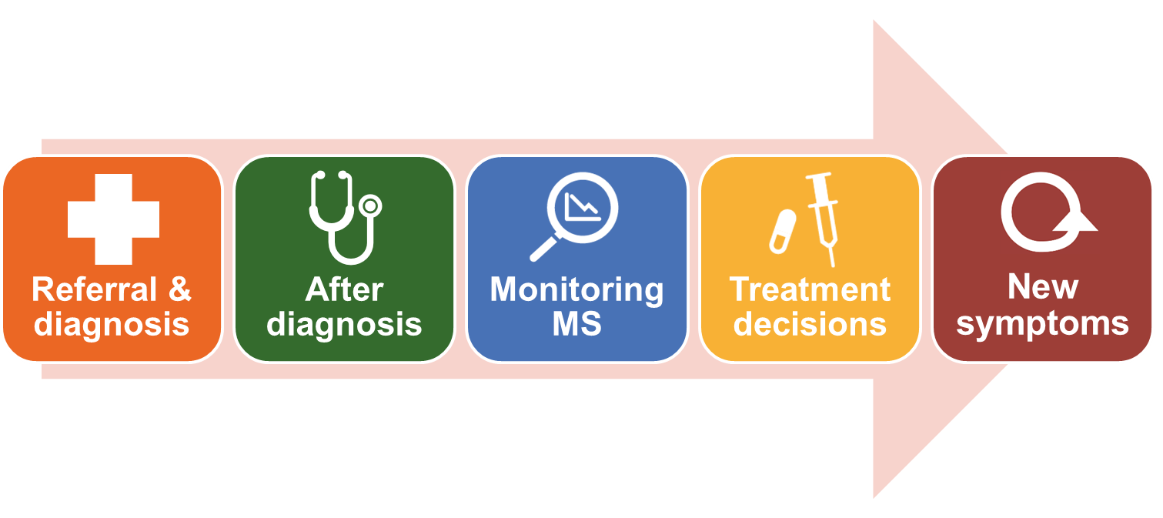



Referral and diagnosis: what timings constitute best practice?
Patient reports first symptoms possibly related to MS symptoms to HCP
Patient is referred to neurologist
MRI scan
Diagnostic workup completed
Patient receives a diagnosis of MS
Results discussed with the patient within
Patient offered an initial appointment of
HCP, healthcare professional; MRI, magnetic resonance imaging

Slide 22
Referral and diagnosis: core standards
Patient reports first symptoms possibly related to MS symptoms to HCP
4 weeks
Patient is referred to neurologist
4 weeks
4 weeks
MRI scan
Diagnostic workup completed
Patient receives a diagnosis of MS
Results discussed with the patient within
Patient offered an initial appointment of
4 weeks
30 mins
HCP, healthcare professional; MRI, magnetic resonance imaging

Slide 23
Referral and diagnosis: achievable standards
Patient reports first symptoms possibly related to MS symptoms to HCP
10 days
Patient is referred to neurologist
2 weeks
4 weeks
MRI scan
Diagnostic workup completed
Patient receives a diagnosis of MS
Results discussed with the patient within
Patient offered an initial appointment of
10 days
45 min
HCP, healthcare professional; MRI, magnetic resonance imaging

Slide 24
Referral and diagnosis: aspirational standards
Patient reports first symptoms possibly related to MS symptoms to HCP
5 days
Patient is referred to neurologist
5 days
5 days
MRI scan
Diagnostic workup completed
Patient receives a diagnosis of MS
Results discussed with the patient within
Patient offered an initial appointment of
5 days
1 hour
HCP, healthcare professional; MRI, magnetic resonance imaging

Slide 25

Priorities following diagnosis: what timings constitute best practice?
Diagnosis
Aims of treatment discussed
Pros and cons of early treatment discussed
Eligibility for treatment with a suitable DMT discussed
Importance of brain-healthy lifestyle discussed
Referral to services to support lifestyle modifications, if needed
DMT, disease-modifying therapy

Slide 26
Priorities following diagnosis: core standards
Diagnosis
4 weeks
Aims of treatment discussed
6 weeks
Pros and cons of early treatment discussed
6 weeks
Eligibility for treatment with a suitable DMT discussed
3 months
Importance of brain-healthy lifestyle discussed
Referral to services to support lifestyle modifications, if needed
6 months
DMT, disease-modifying therapy

Slide 27
Priorities following diagnosis: achievable standards
Diagnosis
2 weeks
Aims of treatment discussed
3 weeks
Pros and cons of early treatment discussed
3 weeks
Eligibility for treatment with a suitable DMT discussed
4 weeks
Importance of brain-healthy lifestyle discussed
Referral to services to support lifestyle modifications, if needed
3 months
DMT, disease-modifying therapy

Slide 28
Priorities following diagnosis: aspirational standards
Diagnosis
7 days
Aims of treatment discussed
7 days
Pros and cons of early treatment discussed
3 weeks
Eligibility for treatment with a suitable DMT discussed
10 days
Importance of brain-healthy lifestyle discussed
Referral to services to support lifestyle modifications, if needed
4 weeks
DMT, disease-modifying therapy

Slide 29


Routine monitoring: what frequencies constitute best practice?
Review of currently prescribed DMT
Follow-up clinical evaluation
Active, documented discussion about living a brain-healthy lifestyle
Review of treatment aims
Check-up to screen for and/or
manage comorbidities
Review of eligibility to receive a DMT
Offer of an MRI scan
DMT, disease-modifying therapy; MRI, magnetic resonance imaging

Slide 30
Routine monitoring: core standards
Review of currently prescribed DMT
1 year
1 year
Follow-up clinical evaluation
1 year
Active, documented discussion about living a brain-healthy lifestyle
Review of treatment aims
1 year
Check-up to screen for and/or
manage comorbidities
1 year
1 year
Review of eligibility to receive a DMT
Offer of an MRI scan
2 years
DMT, disease-modifying therapy; MRI, magnetic resonance imaging

Slide 31
Routine monitoring: achievable standards
Review of currently prescribed DMT
6 months
6 months
Follow-up clinical evaluation
6 months
Active, documented discussion about living a brain-healthy lifestyle
Review of treatment aims
6 months
Check-up to screen for and/or
manage comorbidities
6 months
6 months
Review of eligibility to receive a DMT
Offer of an MRI scan
1 year
DMT, disease-modifying therapy; MRI, magnetic resonance imaging

Slide 32
Routine monitoring: aspirational standards
Review of currently prescribed DMT
6 months
-
Follow-up clinical evaluation
-
Active, documented discussion about living a brain-healthy lifestyle
Review of treatment aims
6 months
Check-up to screen for and/or
manage comorbidities
6 months
-
Review of eligibility to receive a DMT
Offer of an MRI scan
1 year
DMT, disease-modifying therapy; MRI, magnetic resonance imaging. - = threshold for consensus was not reached.

Slide 33


Treatment decisions: what timings constitute best practice?
Patient becomes eligible for a DMT
Patient has suboptimal response to DMT
Within 2 weeks
Within 3 weeks
Patient offered appropriate DMT
Patient agrees to start DMT
Treatment with DMT commences
DMT, disease-modifying therapy

Slide 34
Treatment decisions: core standards
Patient becomes eligible for a DMT
Patient has suboptimal response to DMT
Within 2 weeks
2 months
3 months
Within 3 weeks
Patient offered appropriate DMT
Patient agrees to start DMT
4 weeks
Treatment with DMT commences
DMT, disease-modifying therapy

Slide 35
Treatment decisions: achievable standards
Patient becomes eligible for a DMT
Patient has suboptimal response to DMT
Within 2 weeks
3 weeks
4 weeks
Within 3 weeks
Patient offered appropriate DMT
Patient agrees to start DMT
2 weeks
Treatment with DMT commences
DMT, disease-modifying therapy

Slide 36
Treatment decisions: aspirational standards
Patient becomes eligible for a DMT
Patient has suboptimal response to DMT
Within 2 weeks
10 days
2 weeks
Within 3 weeks
Patient offered appropriate DMT
Patient agrees to start DMT
7 days
Treatment with DMT commences
DMT, disease-modifying therapy

Slide 37

Managing new symptoms: what timings constitute best practice?
Patient experiences new or worsened symptoms
Patient reports symptoms to MS team
MS team responds
Patient seen by relevant member of MS team

Slide 38
Managing new symptoms: core standards
Patient experiences new or worsened symptoms
2 weeks
Patient reports symptoms to MS team
3 days
MS team responds
7 days
Patient seen by relevant member of MS team

Slide 39
Managing new symptoms: achievable standards
Patient experiences new or worsened symptoms
7 days
Patient reports symptoms to MS team
2 days
MS team responds
3 days
Patient seen by relevant member of MS team

Slide 40
Managing new symptoms: aspirational standards
Patient experiences new or worsened symptoms
3 days
Patient reports symptoms to MS team
1 day
MS team responds
2 days
Patient seen by relevant member of MS team

Slide 41
How important/urgent is it to measure current practice against these standards?
Urgent
After diagnosis
Discussion of importance of
brain-healthy lifestyle
Unimportant
Important
Monitoring MS
Review of currently prescribed DMT
Monitoring MS
Check-ups to screen for and/or
manage comorbidities
Not urgent
DMT, disease-modifying therapy

Slide 42
At which stage in the pathway do delays impact most on patient care in your experience?
Notes:
Suggested interactive slide

Slide 43
Conclusions
First global study to establish consensus on timing of key steps in the
MS care pathway
A benchmark that will help individual MS services globally strive for the
highest level of care
An MS Brain Health tool is in development, based on these standards, to support clinics in assessing their practice
The MS community is invited to engage in its development and roll-out
To find out how you can be involved, email info@msbrainhealth.org

Slide 44

Our vision is to create a better future for
people with MS and their families
Your voice will help to drive this change
Commit to supporting the MS Brain Health recommendations at www.msbrainhealth.org

