Slide 1
Guidance for presenters
This slide deck is intended to be used for the education of people with multiple sclerosis (MS)
Sections of this slide deck may be presented independently; however, the funding statement on the title slide should always be retained and presented alongside any material obtained from this slide deck
Please include your own Conflict of Interest statement at the start of the presentation if necessary, in keeping with the compliance regulations in your own country and the country where the slides are being presented

Slide 2
Brain health: a guide for people with multiple sclerosis

Slide 3
Report published October 2015
Importance of brain health in multiple sclerosis (MS) and the need for urgency at
every stage
Evidence-based international consensus recommendations
Authored by international experts and endorsed by professional societies and
advocacy groups

Slide 4











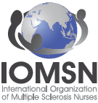



































Report endorsed by professional societies and advocacy groups
Updated 22 August 2018. Endorsements received since this date can be found at www.msbrainhealth.org.

Slide 5

A guide for people with MS is now available
How the guide can help you
  Everyone with MS
    embrace a ‘brain-healthy’ lifestyle
    explain to HCPs what matters to you
    help to monitor your MS by keeping a diary of things that affect your
    health and wellbeing
    be informed about your MS so that you can share decision-making
    with your HCPs
  People at/very near to diagnosis
    ask for urgent referral to a neurologist and access to
    diagnostic services
    start treatment as early as possible with a DMT (if appropriate)
  People with relapsing forms of MS
    discuss monitoring of your MS using MRI brain scans
    be confident discussing the possibility that disease activity
    may be ongoing even when you are feeling well
DMT, disease-modifying therapy; HCP, healthcare professional; MRI, magnetic resonance imaging

Slide 6






Recommendations of the guide for people with MS
The guide recommends keeping your brain as healthy as possible
It recommends:
Understanding the importance of brain health
  Living a brain-healthy lifestyle
  Earliest possible referral
  and diagnosis
  Monitoring of disease activity
  Early treatment with an appropriate DMT
  Informed, shared
  decision-making
DMT, disease-modifying therapy
Notes:
The guide was designed to help people with MS understand how they can keep their brains as healthy as possible, and request the highest possible standard of care from healthcare professionals.

Slide 7
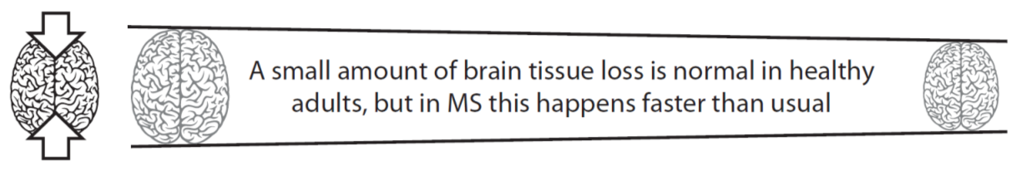
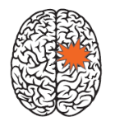

1. The importance of brain health
A small amount of brain tissue loss is normal in healthy adults, but in MS this happens faster than usual
New lesions appear – all cause tissue loss (white), but only some lead to relapses (orange)
Adapted with permission from Oxford PharmaGenesis from Giovannoni G et al. Brain health: time matters in multiple sclerosis, © 2015 Oxford PharmaGenesis Ltd.
Notes:
In MS, the body’s immune system mistakenly attacks and damages tissue in the brain, spinal cord and optic nerve (the central nervous system).
Although it is normal for healthy adults to lose small amounts of brain tissue as they get older, this process happens more quickly in people with MS.^{1,2}
For many people with the disease, this causes physical disability, fatigue and cognitive problems (e.g. difficulties with concentration, memory and learning new things).
In addition, for many people with MS, areas of intensive damage (known as lesions) may noticeably disrupt nerve function and lead to attacks of worsened symptoms and impairment (known as relapses). All lesions contribute to tissue loss even if they do not cause a relapse.
References
De Stefano N et al. CNS Drugs 2014;28:147–56.
De Stefano N et al. J Neurol Neurosurg Psychiatry 2016;87:93–9.

Slide 8

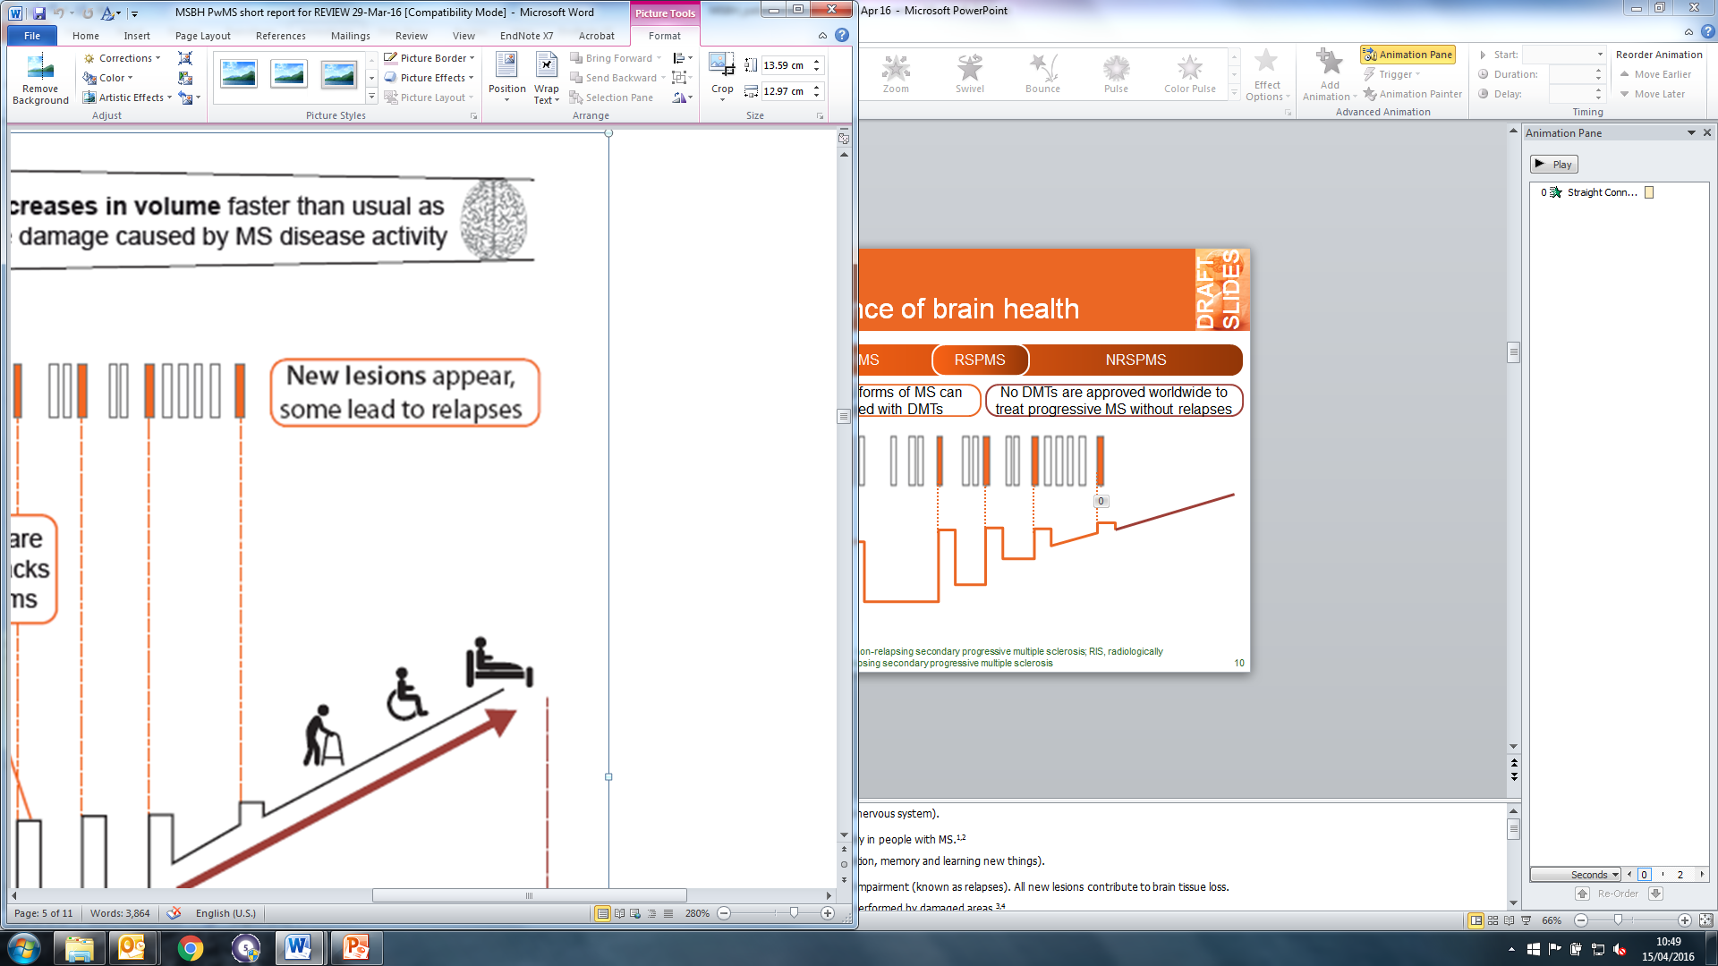



1. The importance of brain health
Neurological reserve declines
The finite capacity of the brain to adapt to damage – neurological reserve – is slowly used up
Disability progression is more likely if all of the brain’s neurological reserve has been used up
Adapted with permission from Oxford PharmaGenesis from Giovannoni G et al. Brain health: time matters in multiple sclerosis, © 2015 Oxford PharmaGenesis Ltd.
Notes:
The brain is a remarkably flexible organ. When learning new skills, such as speaking a foreign language or playing a musical instrument, it can recruit new areas to use for these tasks. In a similar way, if a part of the brain has been damaged, new areas can be recruited to help with the tasks previously performed by the damaged area. Thus, new areas of the brain can be recruited to compensate when MS causes damage to brain tissue.^{1,2}
The capacity of the brain to adapt is known as neurological reserve, and the more neurological reserve a brain has the healthier it is. However, it is now known that MS can be active even when someone is feeling well. Research has shown that only about one in 10 lesions leads to a relapse,^{3,4} and that other, less noticeable, damage can also be ongoing.⁵ So, even if someone is not experiencing new or worsened symptoms, the brain may be using up some of its neurological reserve to compensate for damage. If all of its neurological reserve is used up, the brain can no longer recruit new areas and the symptoms of MS are more likely to progress.
Neurological reserve is a valuable resource that plays a large part in having a healthy brain that functions well. Section 4 of this slide deck explains how you can take positive action to maximize your lifelong brain health whatever your MS diagnosis.
References
Rocca MA et al. Neuroimage 2003;18:847–55.
Rocca MA et al. J Neuroimaging 2007;17 Suppl 1:s36–41.
Barkhof F et al. Am J Roentgenol 1992;159:1041–7.
Kappos L et al. Lancet 1999;353:964–9.
Filippi M et al. J Neurol 2005;252 Suppl 5:16–24.

Slide 9
2. Early referral and diagnosis
Ask for urgent referral to a neurologist if MS is suspected, preferably to one with a special interest in MS, or to an MS specialist clinic
Request early access to diagnostic procedures, including MRI
  It is now possible to diagnose MS earlier than ever before, thanks to evidence from MRI brain scans¹
Stay in touch with your MS team for ongoing monitoring if you do not receive a diagnosis straight away
MRI, magnetic resonance imaging
1. Polman CH et al. Ann Neurol 2011;69:292–30
Notes:
About one in five people who have had a single relapse can receive a firm diagnosis from their first MRI scans.¹
For others, further appointments for MRI scans and clinical examinations will ensure that a diagnosis can be made as soon as possible.
A prompt diagnosis means that people with MS and their healthcare professionals can start to treat and manage the disease as early as possible.
References
Runia TF et al. Eur J Neurol 2013;20:1510–16.

Slide 10
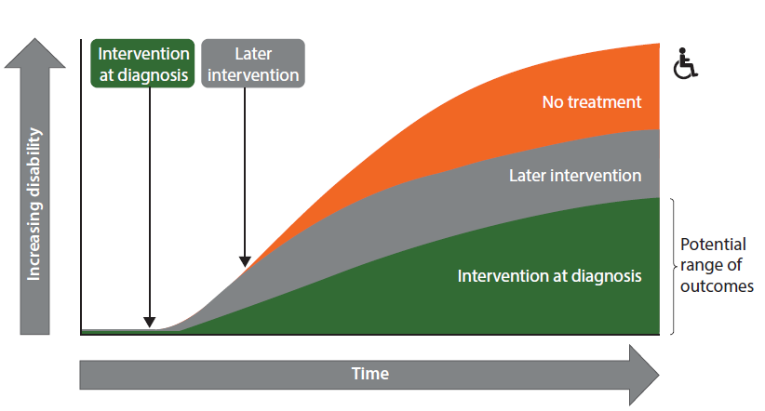
3. Early treatment with a disease-modifying therapy:
Start treatment as soon as possible if appropriate
In people with relapsing forms
of MS, starting treatment with a DMT early in the disease course
(if appropriate) is associated with better long-term outcomes than delaying treatment¹
DMT, disease-modifying therapy
1. Giovannoni G et al. 2015. Appendix 1. Brain health: time matters in multiple sclerosis;57–60.
Adapted with permission from Oxford PharmaGenesis from Giovannoni G et al. Brain health: time matters in multiple sclerosis, © 2015 Oxford PharmaGenesis Ltd.

Slide 11

3. Early treatment with a disease-modifying therapy:
Choose the most appropriate DMT
Different DMTs act on the body in different ways and each is associated with a particular set of benefits and possible side effects
Choosing the most appropriate DMT for you is therefore something to talk about with your HCPs
DMT, disease-modifying therapy; HCP, healthcare professional
1. Giovannoni G et al. 2015. Appendix 1. Brain health: time matters in multiple sclerosis;57–60.
Notes:
Although no DMT has yet been approved worldwide for progressive MS without relapses, it is important to emphasize that everyone with MS can take positive action to manage their disease by living a brain-healthy lifestyle.

Slide 12





4. Lead a brain-healthy lifestyle
Keep as active
as you can
Keep your weight under control
Keep your
mind active
Continue taking
other medicines your doctor has prescribed
Avoid smoking
Watch how much you drink
Notes:
Keep physically active. Higher levels of aerobic fitness are associated with faster information processing and preserved brain tissue volume.^{1,a} This suggests that being as active as possible may help to preserve brain health in people with MS.
Keep your weight under control. Obesity is associated with higher numbers of MS lesions (areas of intensive damage) than maintaining a healthy weight.²
Keep your mind active. Education, reading, hobbies and artistic or creative pastimes help to protect against cognitive problems in MS when pursued over a lifetime.^{3–7}
Avoid smoking. Cigarette smoking is associated with decreased brain volume in people with MS,² as well as with higher relapse rates,⁸ increased disability progression,^{8,9} more cognitive problems¹⁰ and reduced survival¹¹ compared with not smoking
Watch how much you drink. Unsafe levels of alcohol lead to reduced survival in people with MS.¹¹
Take medications prescribed for other diseases. If you have other diseases, be responsible for monitoring and managing them, including taking prescribed medications. Conditions such as high blood pressure, heart disease, diabetes or high cholesterol can worsen the MS disease course.
ªAlthough it is normal for healthy adults to lose small amounts of brain tissue as they get older, this process happens more quickly in people with MS
References
Prakash RS et al. Brain Res 2010;1341:41–51.
Kappus N et al. J Neurol Neurosurg Psychiatry 2015; doi:10.1136/jnnp-2014-310051.
Sumowski JF et al. Neurology 2014;82:1776–83.
Pinter D et al. PLoS One 2014;9:e87567.
Modica CM et al. Mult Scler 2015; doi:10.1177/1352458515579443.
Sumowski JF et al. Neurology 2010;74:1942–5.
Sumowski JF et al. J Int Neuropsychol Soc 2009;15:606–12.
D'Hooghe M B et al. Mult Scler 2010;16:773–85.
Pittas F et al. J Neurol 2009;256:577–85.
Ozcan ME et al. Neuropsychiatr Dis Treat 2014;10:1715–19.
Jick SS et al. J Neurol 2015; doi:10.1007/s00415-015-7796-2.

Slide 13

5. Monitoring of disease activity:
Share a full picture of your health with your HCPs
Anxiety
Painful loss of vision
Depression
Impaired speech
Double vision
Cognitive problems
Sleep disorders
Involuntary crying
Stiffness and painful spasms
Unstable vision
Impaired swallowing
Vertigo
Clumsiness
Bladder problems
Bowel problems
Poor balance
Tremor
Exercise intolerance
Sensitivity to temperature
Fatigue
Sexual problems
Pain
HCP, healthcare professional
Adapted with permission from Oxford PharmaGenesis from Giovannoni G et al. Brain health: time matters in multiple sclerosis, © 2015 Oxford PharmaGenesis Ltd.
Notes:
It can be helpful to keep an MS diary of things that affect your health and wellbeing, such as symptoms, side effects and other diseases, so that you can share a full picture with your healthcare professionals.
Look out for these symptoms, especially the ones shown in green, and keep an MS diary to discuss at appointments with your healthcare professionals.

Slide 14

5. Monitoring of disease activity:
Monitoring is key to maximizing lifelong brain health
Regularly monitoring disease activity using MRI can give early warning that MS is not responding well to treatment
This is because there is more to MS disease activity than meets the eye
Disease activity in the form of lesions and brain tissue loss can predict relapses and disability progression¹
All disease activity damages tissue in the brain and spinal cord even if this doesn’t immediately lead to a relapse
Disability progression
Relapses
Lesions detectable using standard clinical MRI techniques
(white matter)
Brain
tissue loss
MRI or clinical evidence that disease activity is poorly controlled should prompt discussion about the possibility of switching to a DMT that acts on the body in a different way
DMT, disease-modifying therapy; MRI, magnetic resonance imaging
1. Giovannoni G et al. 2015. Appendix 2. Brain health: time matters in multiple sclerosis; pp61–63
Adapted with permission from Oxford PharmaGenesis from Giovannoni G et al. Brain health: time matters in multiple sclerosis, © 2015 Oxford PharmaGenesis Ltd.
Notes:
The iceberg is used as an analogy to show that there is more going on in MS than is visible on the surface. Lesion and brain
The healthcare professionals who oversee your treatment should have a plan to monitor your MS. Information about you and your disease should be put into a logbook that they discuss with you.

Slide 15

6. Informed, shared decision-making
Decisions about DMTs should be informed and shared between you as a person with MS, and your HCPs
You should feel able to discuss your values, needs, limitations, lifestyle, treatment goals and the likely disease course with your HCPs
  When people with MS have open, trust-based relationships with HCPs, they are more likely to continue with treatment,¹ and so are less likely to experience serious relapses²
A well-informed and proactive collaboration with your healthcare
team is an important part of
managing your MS successfully
DMT, disease-modifying therapy; HCP, healthcare professional
1. de Seze J et al. Patient Prefer Adherence 2012;6:263–73; 2. Bunz TJ et al. Value Health 2013;16:A109
Notes:
Prepare for your appointments by making notes about topics you would like to discuss.
Topics of conversation may include employment, starting or extending a family, other lifestyle factors that are important to you, your attitude to risk and feelings about injections, and any other diseases for which you are being treated, including any side effects of your current medication.
A discussion about the relative convenience, effectiveness, possible side effects and specific safety monitoring of the DMTs being considered is also important.

Slide 16
Conclusions 1: What can you do?
Be aware that MS disease activity may be ongoing even when you feel well and that this can threaten brain health
Discuss neurological reserve and brain health with others, including HCPs
Understanding the importance of preserving brain health
Ask for urgent referral to a neurologist if MS is suspected, preferably to one with a specialist interest in MS, or to an MS specialist clinic
Request timely access to diagnostic procedures, including MRI
Stay in touch with your MS team if you do not receive a diagnosis straight away
Early referral
and diagnosis
HCP, healthcare professional

Slide 17
Conclusions 2: What can you do?
Ask your HCPs whether it is appropriate to start treatment with a DMT
Find out what options are available
Early treatment with a disease-modifying therapy (when appropriate)
Embrace a brain-healthy lifestyle that includes keeping physically active, keeping your weight under control, keeping your mind active, not smoking, watching how much you drink and taking any prescribed medications
Living a brain-healthy lifestyle, including treating other diseases
DMT, disease-modifying therapy; HCP, healthcare professional

Slide 18
Conclusions 3: What can you do?
Keep an MS diary and share this information with your HCPs
Discuss strategies for managing your MS
Ask the HCPs who oversee your treatment how they plan to monitor your MS
Ensure that you feel well informed about the results of your clinical assessments and MRI scans
Ask whether it is appropriate to switch to another DMT
Early treatment with a disease-modifying therapy (when appropriate)
A plan to monitor MS disease activity and
to switch therapy if treatment is not working
Be part of the decision-making process together with your HCPs
Prepare for your appointments by making notes about topics you would like to discuss
Explain to your HCPs what matters to you
Look for other resources to help with these conversations
  Your local MS patient organizations may be able to help
Informed, shared decision-making
DMT, disease-modifying therapy; HCP, healthcare professional; MRI, magnetic resonance imaging

Slide 19

Our vision is to create a better future for
people with MS and their families
Your voice will help to effect this change
Commit to supporting the MS Brain Health recommendations at www.msbrainhealth.org

Slide 20
Authored by international experts
Mr George Pepper
shift.ms, Leeds, UK
Professor Helmut Butzkueven
Melbourne Brain Centre, Royal Melbourne Hospital, University of Melbourne, Parkville, Australia
Professor Suhayl Dhib-Jalbut
Department of Neurology, RUTGERS-Robert Wood Johnson Medical School, New Brunswick, NJ, USA
Professor Gavin Giovannoni
Queen Mary University London, Blizard Institute, Barts and The London School of Medicine and Dentistry, London, UK
Professor Eva Havrdová
Department of Neurology, Charles University in Prague, Prague, Czech Republic
Professor Jeremy Hobart
Plymouth University Peninsula Schools of Medicine and Dentistry, Plymouth, UK
Dr Gisela Kobelt
European Health Economics, Mulhouse, France
Dr Maria Pia Sormani
Biostatistics Unit, University of Genoa, Genoa, Italy
Mr Christoph Thalheim
Patient Advocate in Multiple Sclerosis, Brussels, Belgium
Professor Anthony Traboulsee
Department of Medicine, University of British Columbia, Vancouver, BC, Canada
Professor Timothy Vollmer
Department of Neurology, University of Colorado Denver, Aurora, CO, USA

